Slide 1
8051 Microcontroller – Timer Programming
Text Book Referred: Muhammad Ali Mazidi - The 8051 Microcontroller and Embedded Systems

Slide 2
Port 3 Signals

Slide 3
Concepts of 8051 Timer Programming
The 8051 has two timers/counters, they can be used either as
Timers to generate a time delay or as Event counters to count events happening outside the microcontroller
Both Timer 0 and Timer 1 are 16 bits wide Since 8051 has an 8-bit architecture, each 16-bits timer is accessed as two separate registers of low byte and high byte

Slide 4
Timer 0 and Timer 1
Accessed as low byte and high byte
The low byte register is called TL0/TL1 and
The high byte register is called TH0/TH1
Accessed like any other register
MOV TL0,#4FH
MOV R5,TH0

Slide 5
Timer Mode Register (TMOD)
Both timers 0 and 1 use the same register, called TMOD (timer mode), to set the various timer operation modes.
TMOD is a 8-bit register
The lower 4 bits are for Timer 0
The upper 4 bits are for Timer 1
In each case,
The lower 2 bits are used to set the timer mode
The upper 2 bits to specify the operation

Slide 6
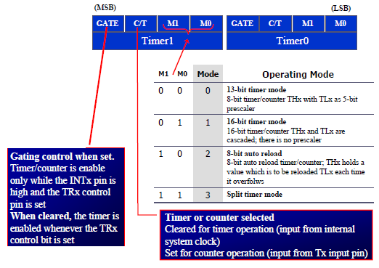
Timer Mode Register (TMOD)

Slide 7
GATE Bit in TMOD Register
Timers of 8051 do starting and stopping by either software or hardware control
In using software to start and stop the timer where GATE=0
The start and stop of the timer are controlled by way of software by the TR (timer start) bits TR0 and TR1
– The SETB instruction starts it, and it is stopped by the CLR instruction
– These instructions start and stop the timers as long as GATE=0 in the TMOD register
The hardware way of starting and stopping the timer by an external source is achieved by making GATE=1 in the TMOD register

Slide 8
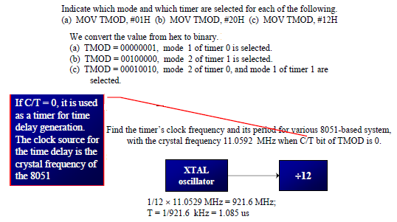
Timer Mode Register (TMOD)

Slide 9
C/T Bit in TMOD Register
The C/T bit in the TMOD registers decides the source of the clock for the timer
When C/T = 1, the timer is used as a counter and gets its pulses from outside the 8051
The counter counts up as pulses are fed from pins 14 and 15, these pins are called T0 (timer 0 input) and T1 (timer 1 input)

Slide 10
TCON Register
TCON (timer control) register is an 8-bit register
TCON register is a bit-addressable Register
If GATE = 1, the start and stop of the timer are done externally through pins P3.2 and P3.3 for timers 0 and 1, respectively

Slide 11
Delay Calculation
Calculate the amount of time delay in the DELAY subroutine generated by the timer. Assume XTAL = 11.0592 MHz.
Solution:
The timer works with a clock frequency of 1/12 of the XTAL frequency; therefore, we have 11.0592 MHz / 12 = 921.6 kHz as the timer frequency.
As a result, each clock has a period of T = 1/921.6kHz = 1.085us.
In other words, Timer 0 counts up each 1.085 us resulting in delay = number of counts × 1.085us.
The number of counts for the roll over is FFFFH – FFF2H = 0DH (13 decimal).
However, we add one to 13 because of the extra clock needed when it rolls over from FFFF to 0 and raise the TF flag.
This gives 14 × 1.085us = 15.19us for half the pulse.
For the entire period it is T = 2 × 15.19us = 30.38us as the time delay generated by the timer.

Slide 12
Delay Calculation
The delay produced by 8051 Mode 1 timer with TH=20 and TL=0F, crystal frequency 11.0592MHz is
Solution:
200F(Hex) in Decimal is 8207
(65536-8207) * 1.085 μsec = 62.201 msec

Slide 13
Frequency Calculation
The following program generates a square wave on pin P1.5 Using timer1, Find the frequency. Consider XTAL = 11.0592 MHz.
MOV TMOD, #10H
AGAIN: MOV TL1, #34H
MOV TH1, #12H
SETB TR1
BACK: JNB TF1, BACK
CLR TR1
CPL P1.5
CLR TF1
SJMP AGAIN
Solution:
FFFFH – 1234H + 1 = EDCCH = 60876 clock count
Half period = 60876 x 1.085us = 66.050 ms
Total period = 2 x 66.050 ms = 132.100ms
Frequency = 1/132.100ms = 7.57 Hz

Slide 14
Timer 0/1 Delay Using Mode 1 (16-bit mode)
8051 C program to toggle all the bits of port P1 continuously with some delay in between.
Use Timer 0, 16-bit mode to generate the delay.
Since, each clock has a period of T = 1/921.6kHz = 1.085us.
Timer 0 counts up each 1.085 us resulting in delay = number of counts × 1.085us.

Slide 15
Timer 0/1 Delay Using Mode 1 (16-bit Non Auto-reload)
The frequency for the timer is always 1/12th the frequency of the crystal attached to the 8051, regardless of the 8051 version.
To toggle Port 1.5 for 50ms delay:

Slide 16
Timer 0/1 Delay Using Mode 2 (8-bit Auto-reload)
8051 C program to toggle only pin P1.5 continuously every 250 ms. Use Timer 0, mode 2 (8-bit auto-reload) to create the delay.
8051 C program to create a frequency of 2500 Hz on pin P2.7. Use Timer 1, mode 2 to create delay.

